Slide 1


FARMING WEB ASSITANCE SERVICES
Aviral Jasiwal(2101220100035)
Himanshu Singh Chauhan(2101220100054)

Slide 2
CONTENT
Project Objective
Work in progress
Project Methodologies
Block of Code
Modules
Output
Work Completed
Problems Faced

Slide 3
PROJECT OBJECTIVE
TO DEVELOP AND CREATE A DIGITAL PLATFORM THAT PROVIDES VALUABLE SUPPORT AND RESOURCES TO THE FARMERS, AGRICULTURAL WORKERS, AND STAKEHOLDERS IN THE AGRICULTURAL INDUSTRY WHICH COULD ADDRESS VARIOUS CHALLENGES AND NEEDS WITHIN THE FARMING SECTOR.
To facilitate connections between farmers and pOTENTIAL BUYERS SUCH AS WHOLESALERS, RETAILERS AND CONSUMERS.
TO REDUCE THE COST AND DEVELOP AN ECONOMICAL AND USER-FRIENDLY GUI APPLICATION.
TO PROVIDE SUGGESTIONS BASED ON A CURRENT WORLD TO ELIMINATE THE NEED TO TRANSLATE THE FULL TERM.

Slide 4
PROJECT METHODOLOGIES
Here's a concise overview of how the Iterative Waterfall model applies to the Farming Web Assisting Services project:
1)Requirements Analysis:
Gather and refine user requirements through iterative feedback.
2)System Design:
•Create a solid design, tested and refined in iterations.
3)Implementation:
•Develop features in phases, adjusting based on continuous feedback.
4)Testing:
•Test early and throughout development, refining as needed.
5)Deployment:
•Deploy the system, then refine with incremental updates.
6)Maintenance:
•Continuously improve the system with regular updates based on evolving needs.

Slide 5
WORK COMPLETED
The User Login frontend module is ready.
The farmer login frontend part is ready.
The authentication page has been designed.
The welcome page is designed.
The complaint page is designed.
The frontend part is 84% ready.
80% backend part has been done.

Slide 6
MODULES
INVENTORY MODULE
A Farming Assistance Inventory System tracks resources like seeds, fertilizers, and machinery, managing stock, availability, and maintenance. It allows farmers to request resources, supports role-based access, and provides analytics for demand forecasting. Built with Django/Flask (backend) and React/Vue (frontend), it ensures efficient resource management.
LISTING OR ADDING TO THE INVENTORY MODULE
The Farming Agro Product Listing Module enables farmers to showcase their produce, including crops, seeds, fertilizers, and equipment. Each listing includes product details, images, pricing, and availability. Buyers can browse, compare, and directly connect with sellers, ensuring a transparent and fair marketplace for agricultural trade.

Slide 7
WORK IN PROGRESS
Backend and database
In percentage
The work on database started started.
The work on connection of the database is to be done.
Working on other modules as well.
85% of the project is completed
83% of frontend
80% of backend

Slide 8
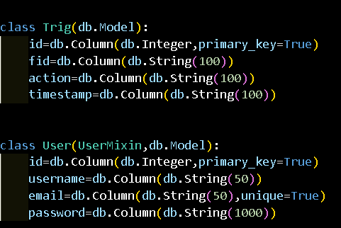
BLOCK OF CODE(INVENTORY MODULE)

Slide 9
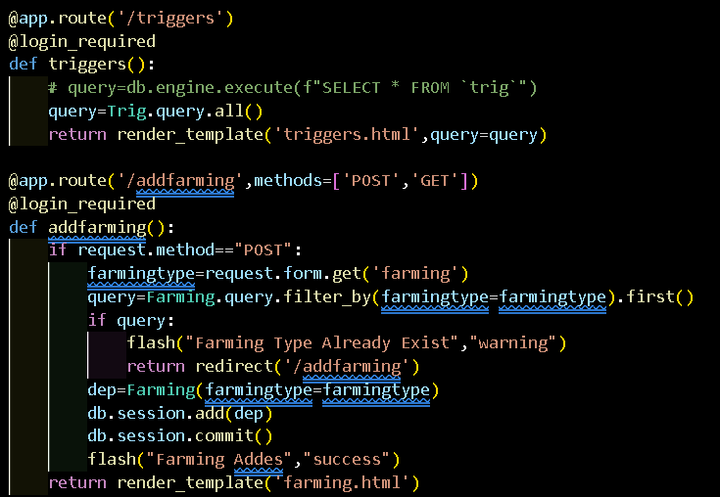
BLOCK OF CODE (ADDING OR LISTING PRODUCTS)

Slide 10
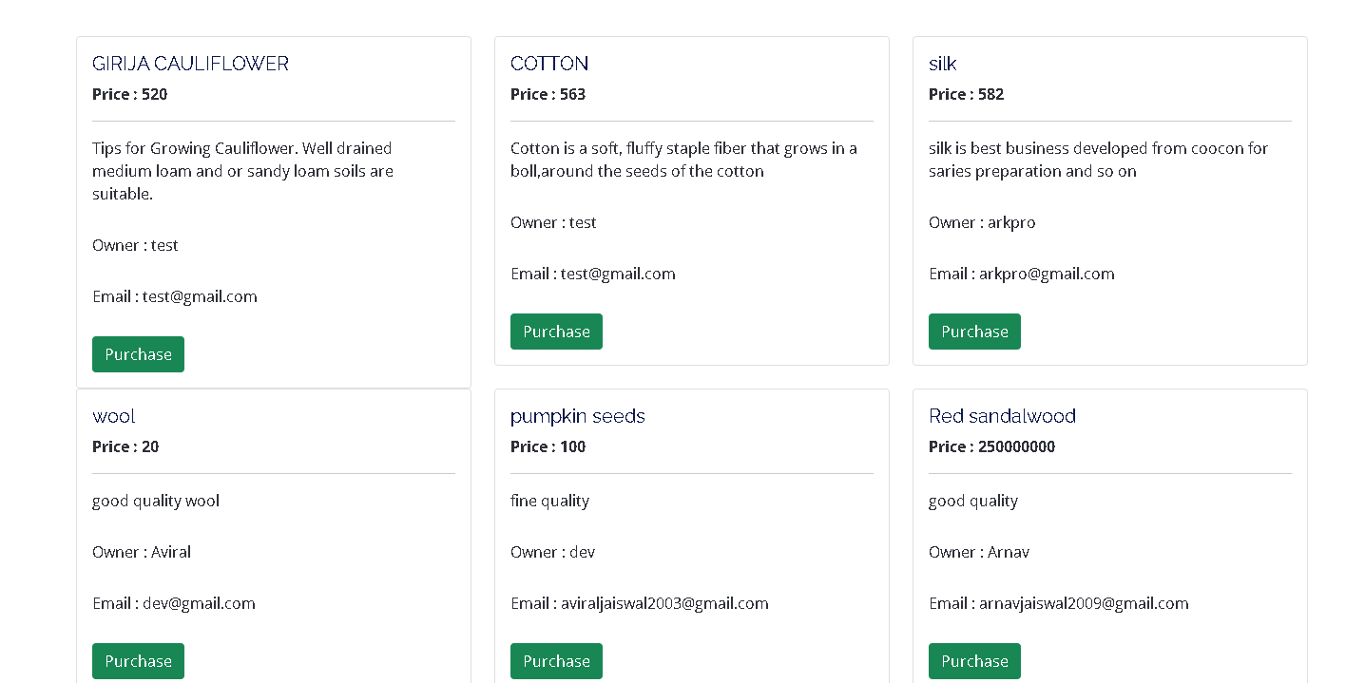
OUTPUT

Slide 11
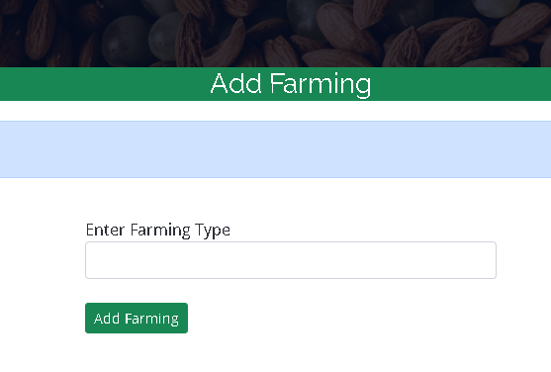
OUTPUT

Slide 12
Thank You
For your attention

